Slide 1

CAREeR POINT JR COLLEGE ECIL, 59456

Slide 2
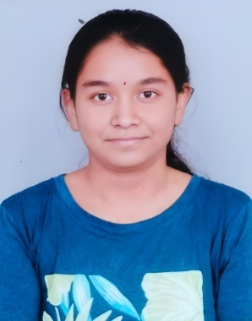
CONGRATULATIONS
OUTSTANDING PERFORMER
VEEKSHANA TEJASWI
467/470

Slide 3
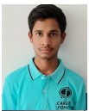
OUTSTANDING PERFORMER
CONGRATULATIONS
P. MAHENDAR REDDY
467/ 470

Slide 4
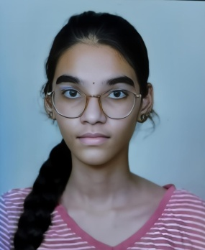
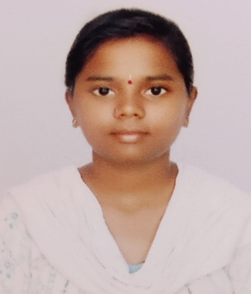
CONGRATULATIONS
466
____________
470
D.RAKSHASRI
R. VAISHNAVI

Slide 5
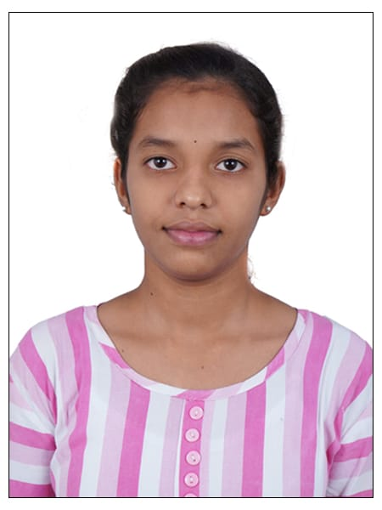
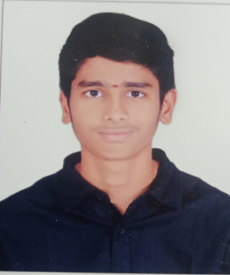
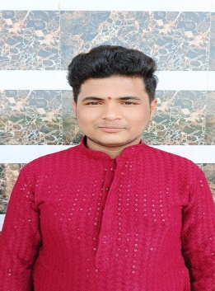
CONGRATULATIONS -- 465/470
A. BADRINATHConference
P. Harshitha
Reddy
N. Dineswar
Reddy
20XX
5

Slide 6
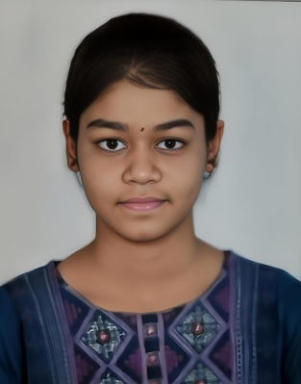
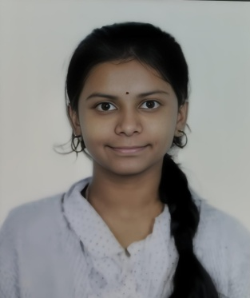
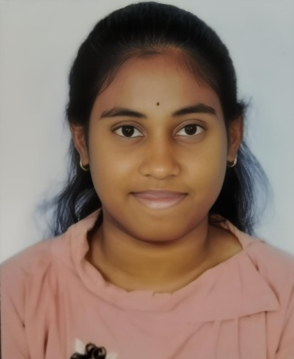
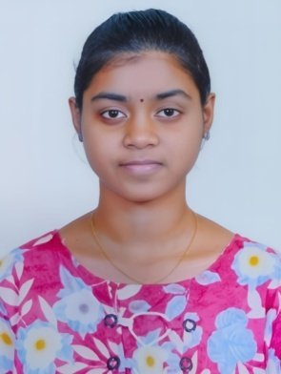
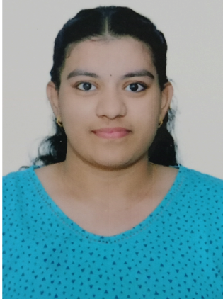
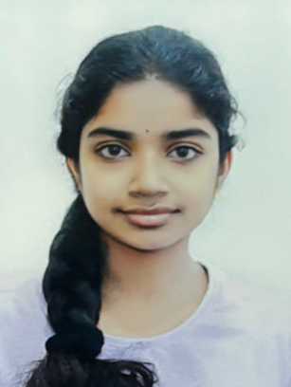
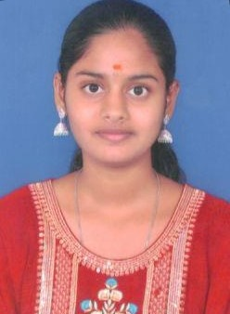
BEST PERFORMERS - 464/470
SAI JOSHITHA
RISHIKA
YUGALA
LAKSHI HUMSINI
SAI DHRUTHI SRI
SRI SAMIHA REDDY
Sai Mahathi
20XX
20XX
Conference presentation
Conference presentation
6
6

Slide 7
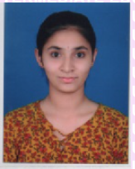
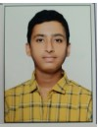
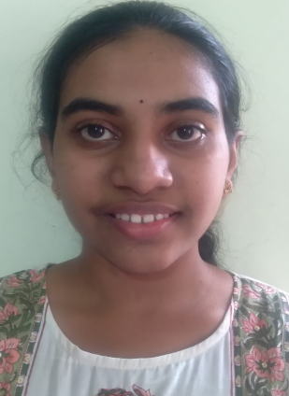
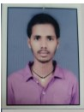
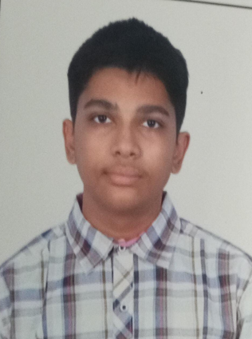
463
470
___________
T. NAGA AKSHAYA
SANDESH REDDY
T.VAMSI
LAKSHMI
SUJITH

Slide 8
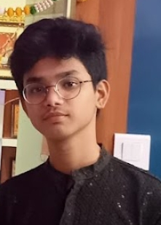
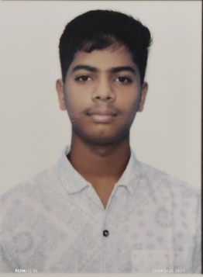
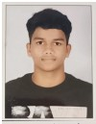
BEST PERFORMERS - 464/470
PRANAY REDDY
M.ARJUN
Ram charan

Slide 9

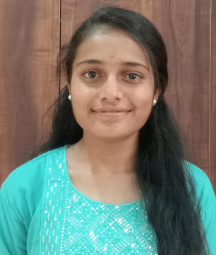
CONGRATULATIONS
2nd YEAR TOPPERS IPE 2025
BINDU SRI
992 / 1000

Slide 10
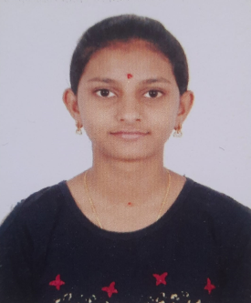
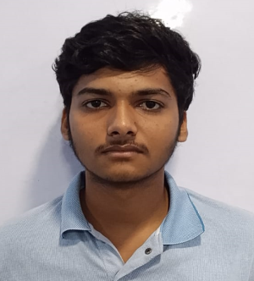
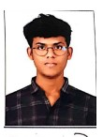
BEST PERFORMERS
B.SPOORTHY
991/1000
CHAITANYA TIRUPATHI REDDY
991/1000
P.GOWTHAM
991/1000

Slide 11
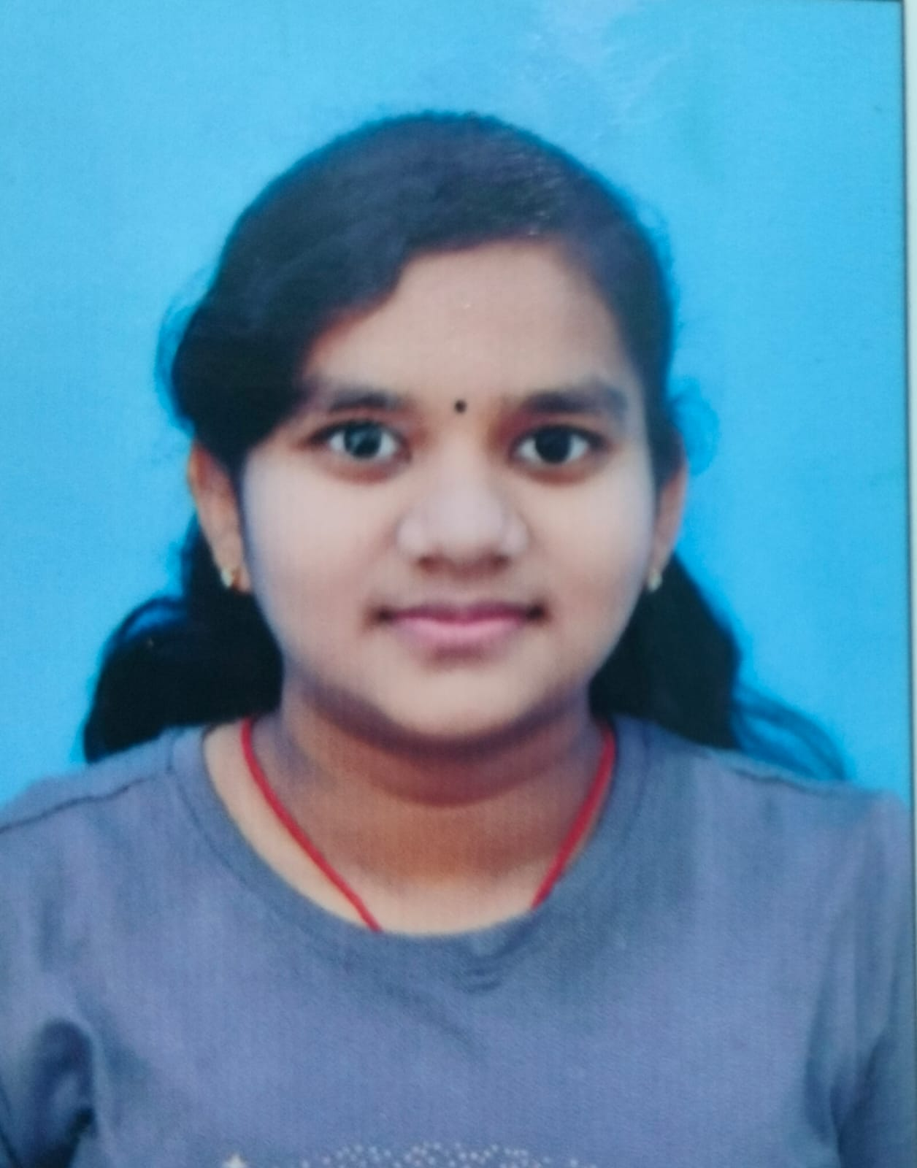
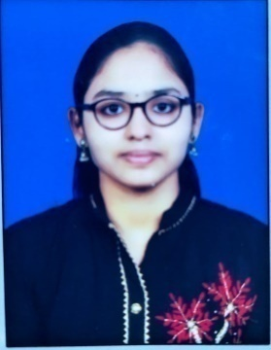
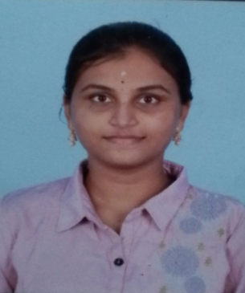
BEST PERFORMERS
NAGA DURGA HASINI
990/1000
P.NIHARIKA
985/1000
HASINI SRISAI
990/1000

Slide 12
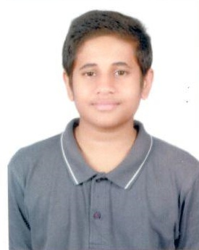
CONGRATULATIONS
Jr NEET
ARUN ADITYA
435/440

Slide 13
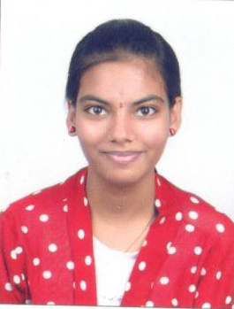
Jr NEET 434/440
R. LEELA

Slide 14
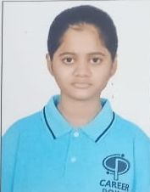
Jr NEET
432/440
HANNAH

Slide 15
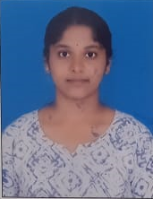
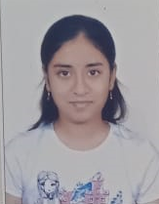
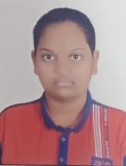
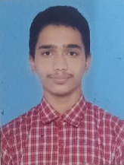
BEST PERFORMERS, NEET
HANSIKA
428/440
YAMINI
426/440
SHRESTA
411/440
AFRESH FRAKINCENSE
413/440

Slide 16
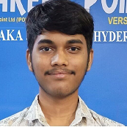
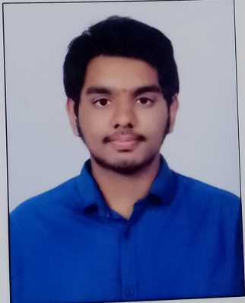
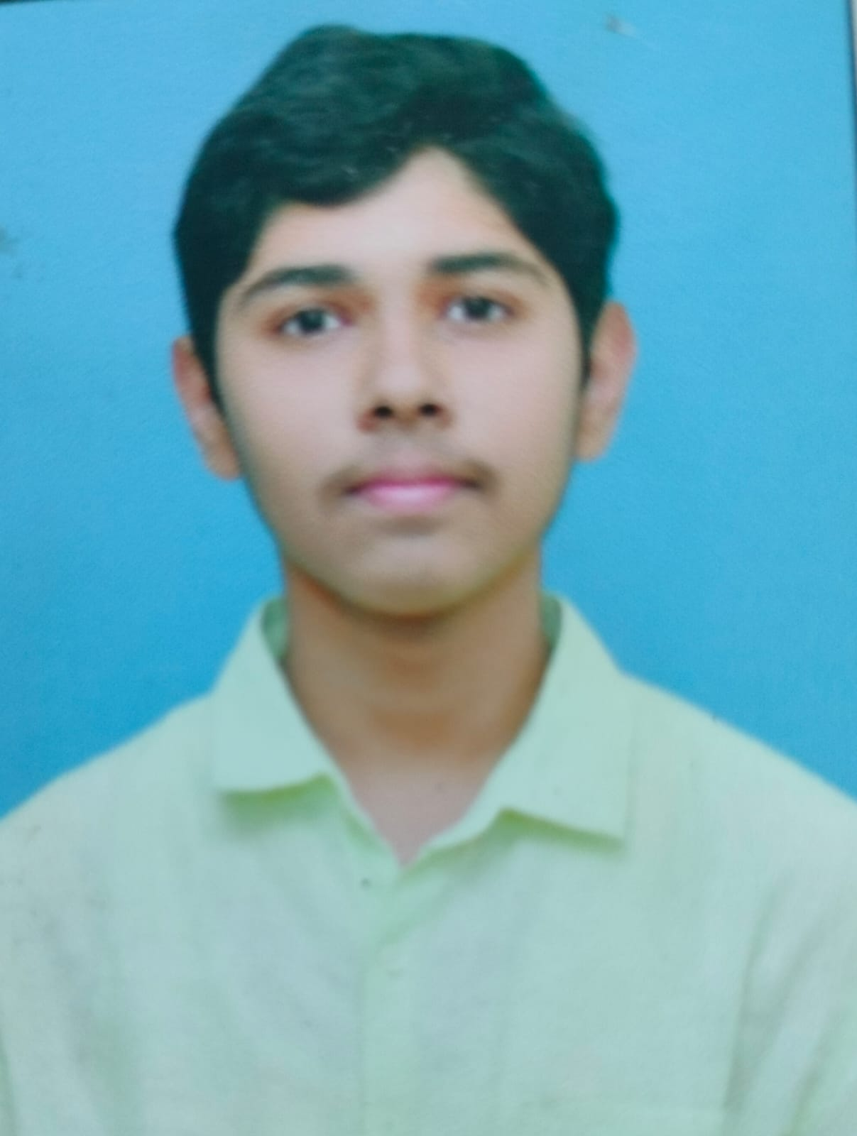
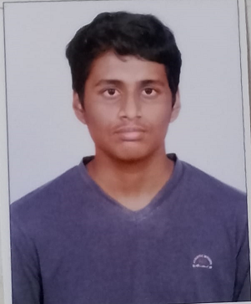
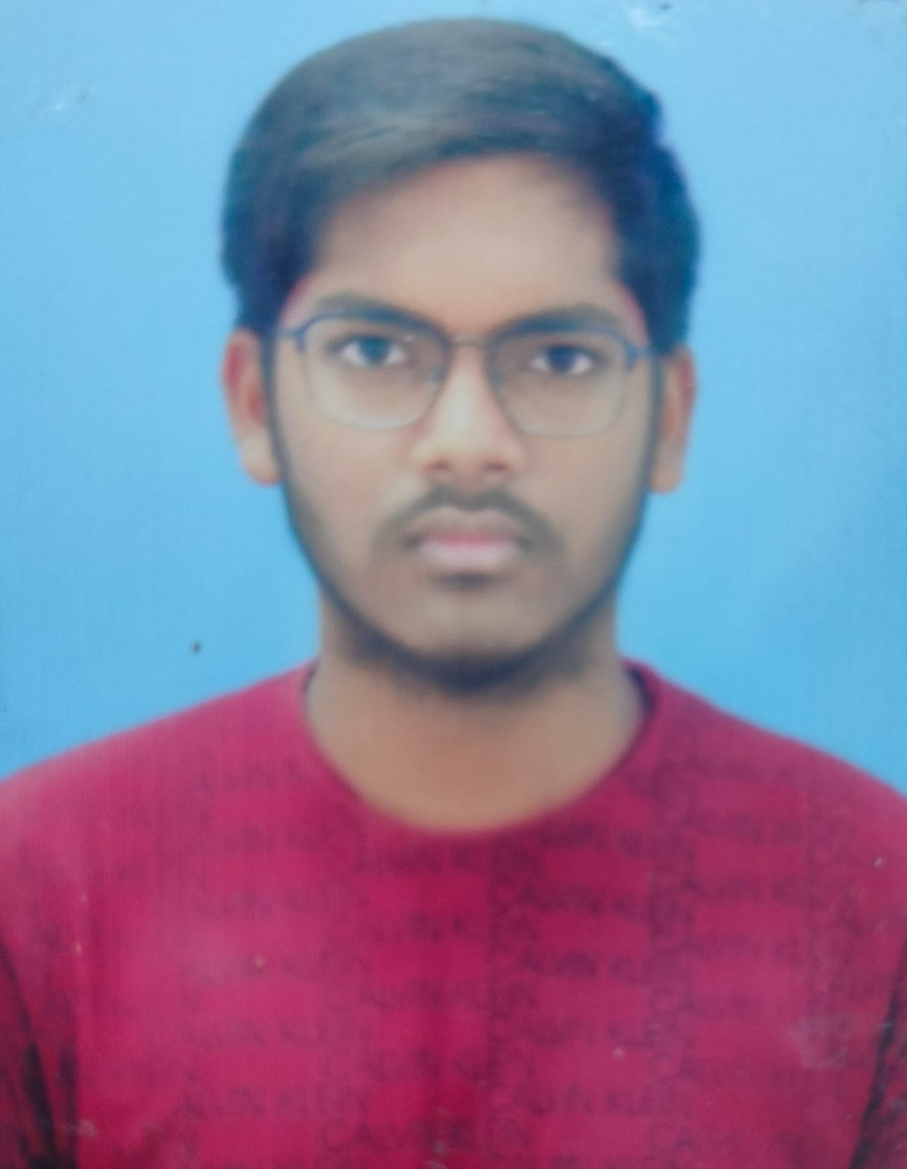
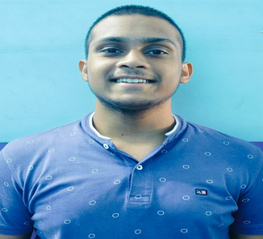
JEE Mains TOPPERS >99%
RAM CHARAN
SUDHISH
PRANAV
VENKATA KRISHNA
BASHEER
BHAVESH

Slide 17
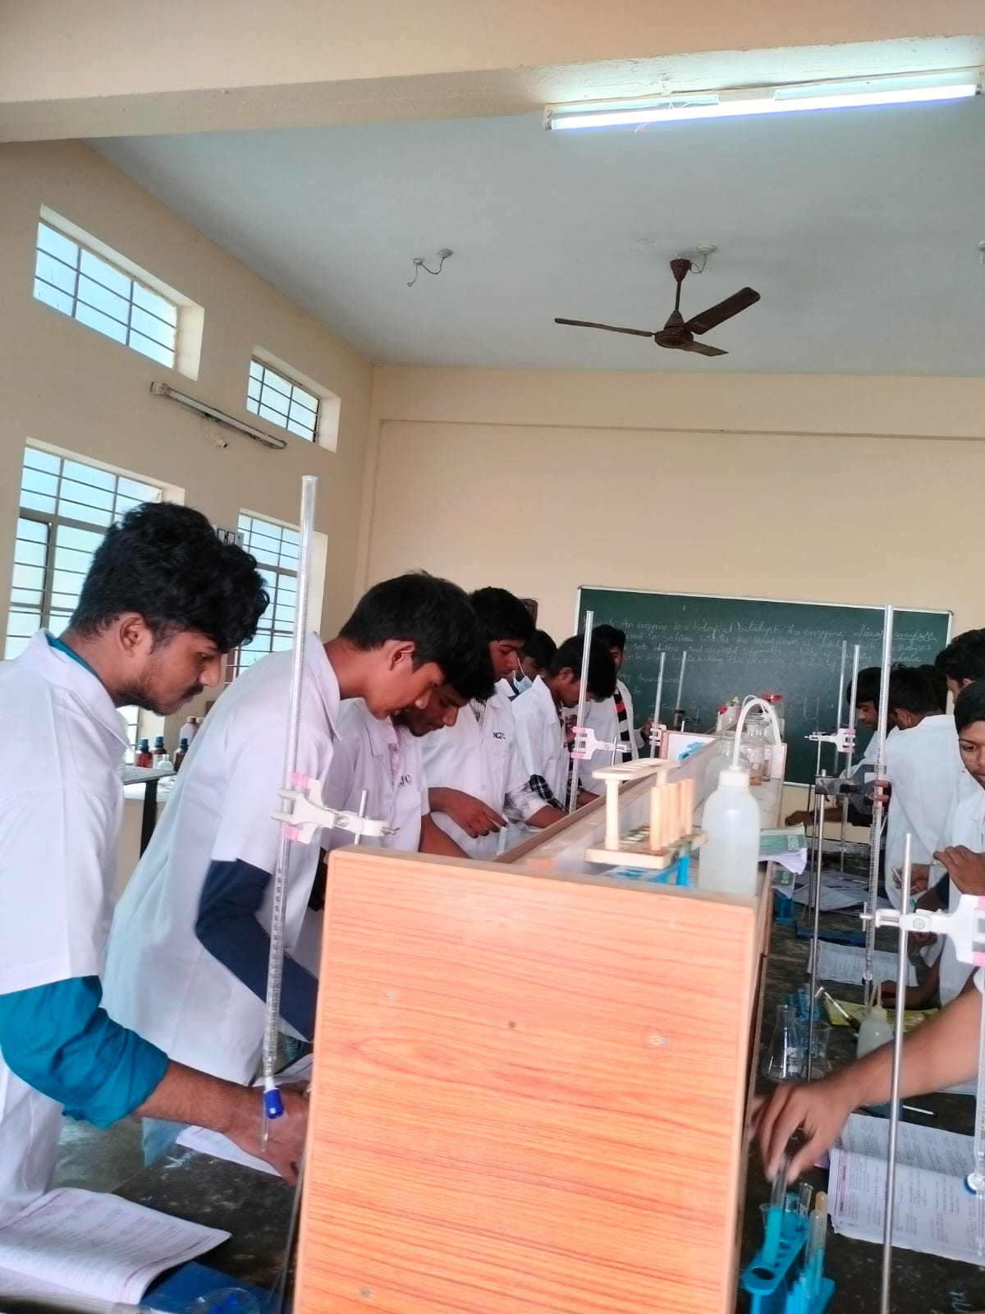
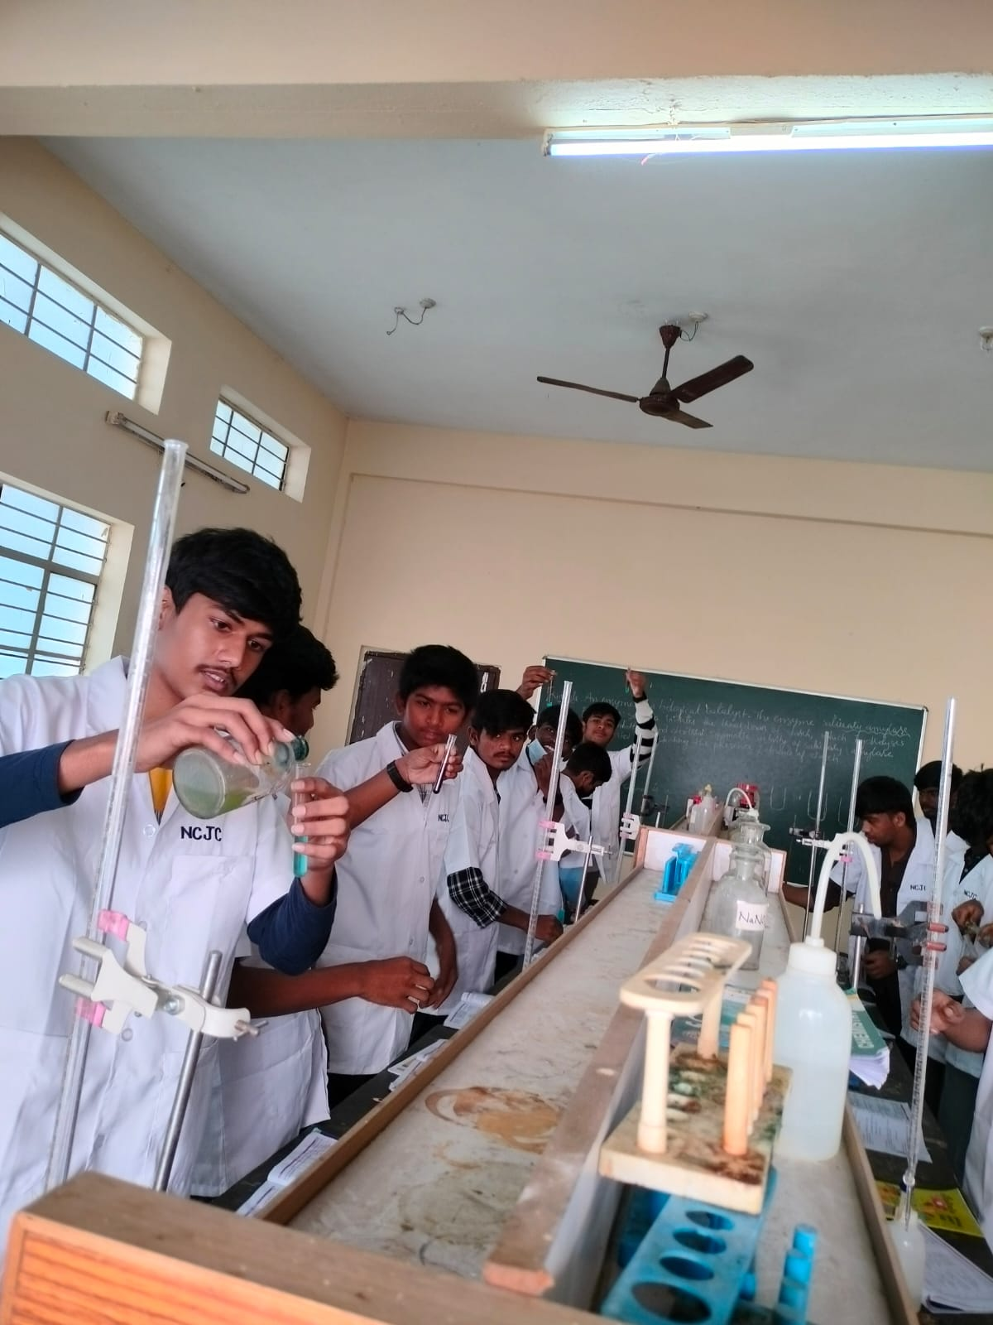

Slide 18
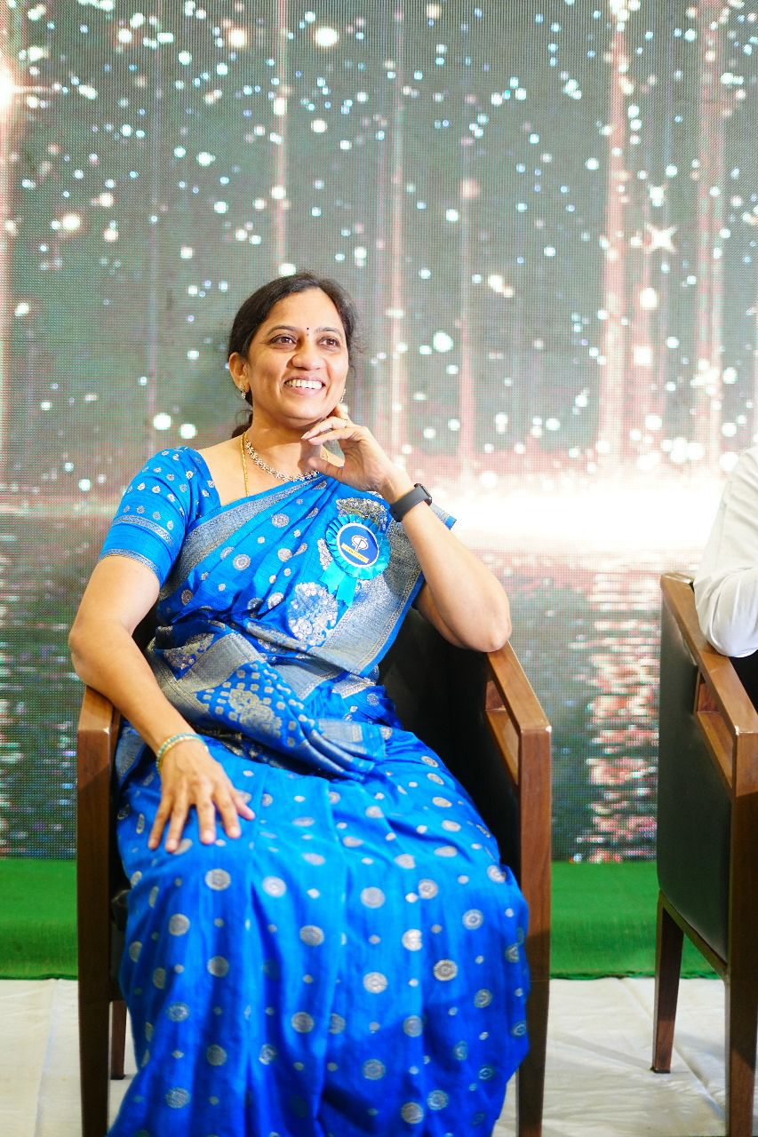
SRIDEVI EMMANENI
CHAIRMAN AND CORRESPONDENT

Slide 19

BRANCHES
ECIL
SUCHITRA
KUKATPALLY
MADHAPUR ( HOSTEL )

Slide 20
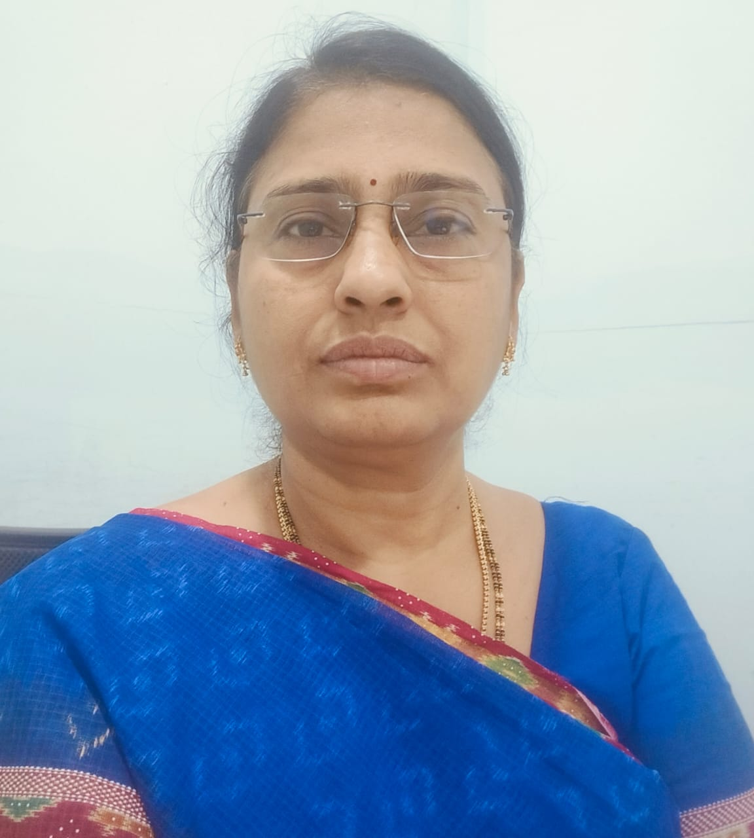
PRINCIPAL
Y. NAGA HARATHI M.SC(Chem),B.ED,PGDCAQM
EXPERIENCE IN TEACHING: 20 + YEARS

Slide 21
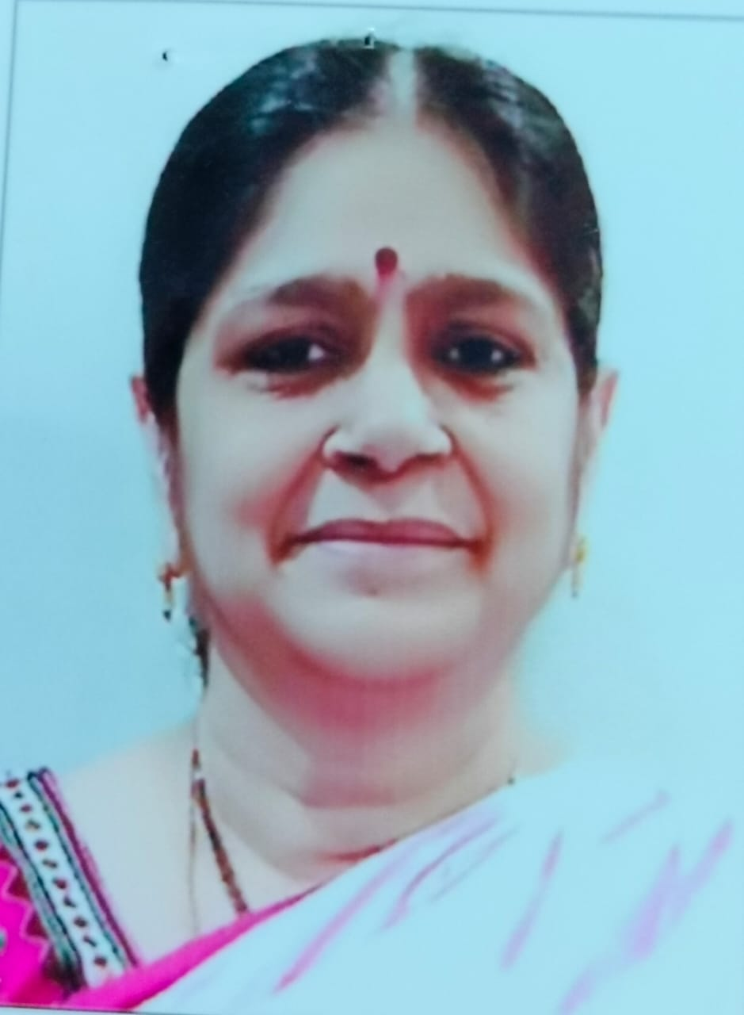
MATHS IIT Faculty
R.LAKSHMI PADMAJA
M.SC(MATHS), M.PHIL
M.SC GOLD MEDALIST
EXPERIENCE : 30 YEARS

Slide 22
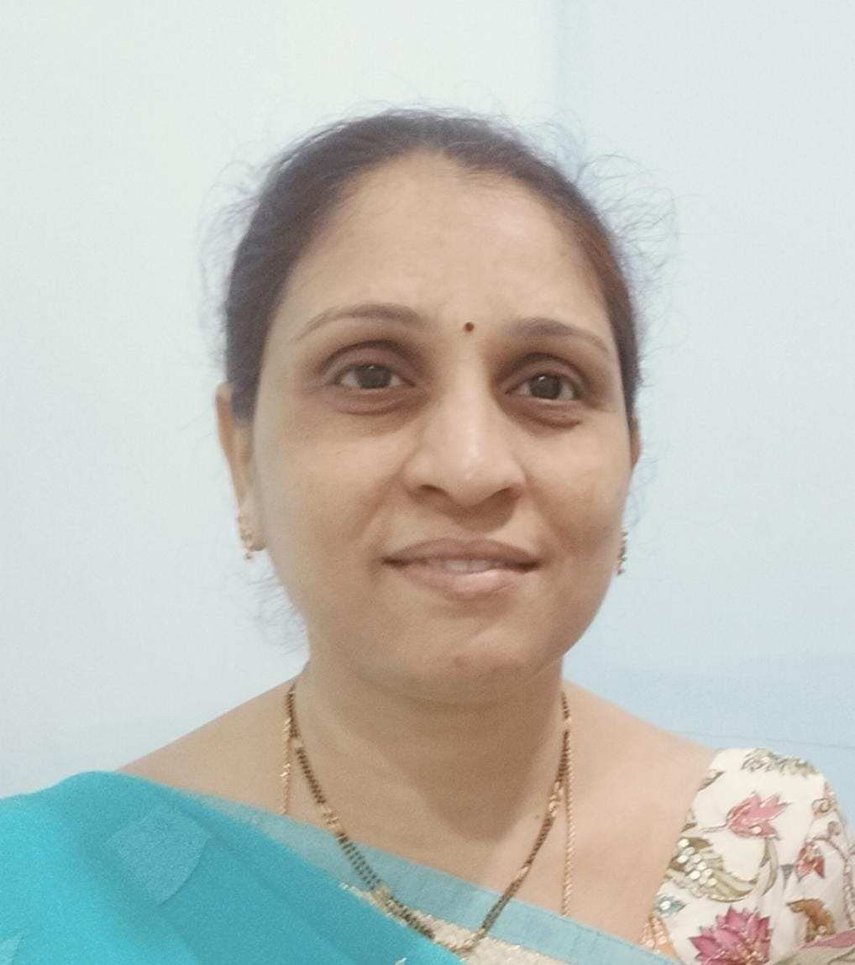
MATHS FACULTY
K. NAGA RANI
M.Sc Maths
Experience: 15 years

Slide 23
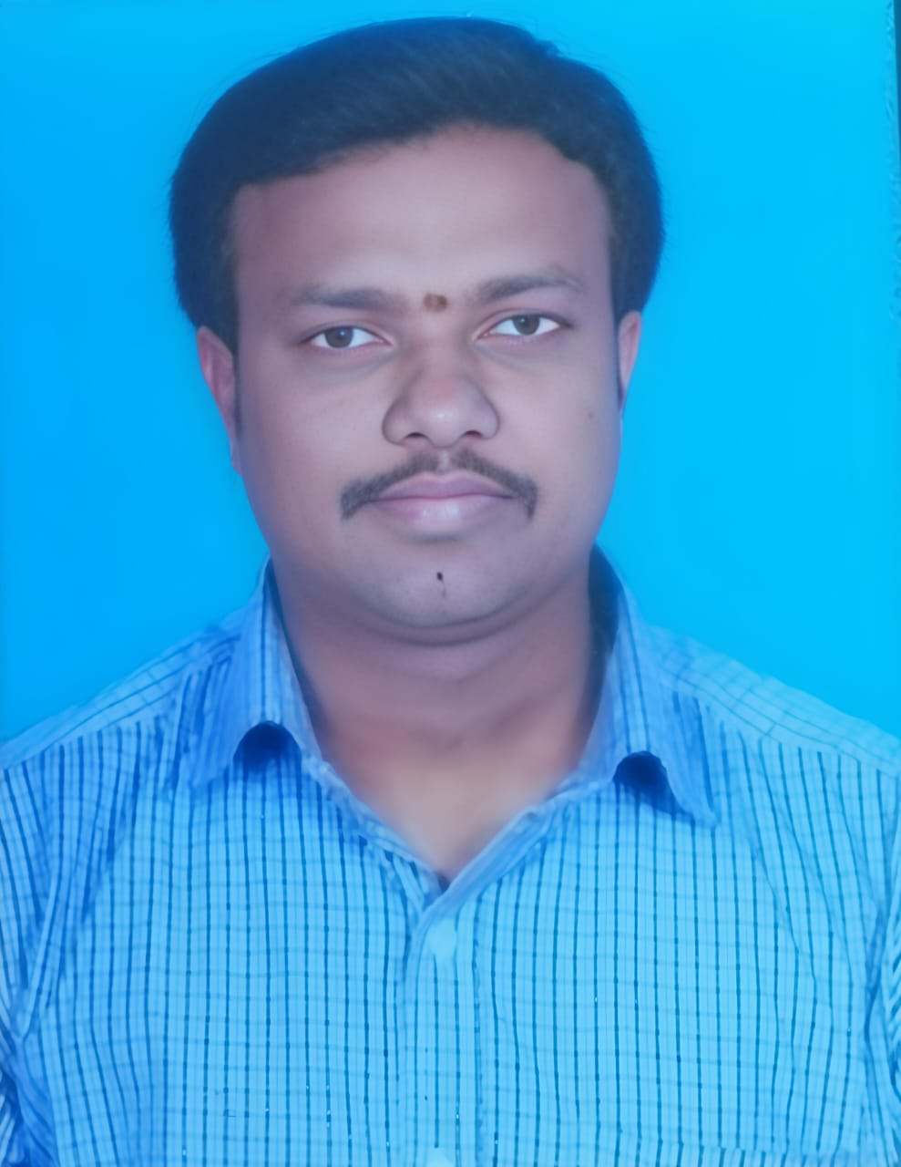
PHYSICS IIT FACULTY
VENKAT REDDY MANDADI
M.Sc PHYSICS
EXPERIENCE : 20 Years

Slide 24
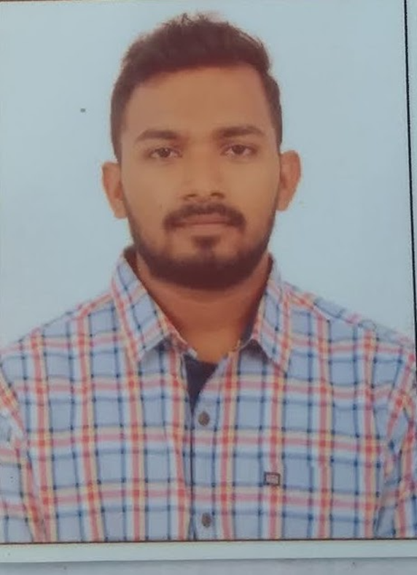
Bhaskar Rao M.Sc Physics
Physics IIT Faculty

Slide 25




CHEMISTRY FACULTY
SUMIT RANJAN
K.NAVEEN KUMAR
M.Sc Chemistry
EXPERIENCE : 6 YEARS
M.Sc Chemistry
EXPERIENCE : 6 YEARS

Slide 26

BIOLOGY FACULTY
RAHUL YADAV
M.Sc MEDICAL MICROBIOLOGY
GOLD MEDALIST
EXPERIENCE – 4 YEARS

Slide 27



BUSINESS DEVELOPMENT TEAM

Slide 28



BUSINESS DEVELOPMENT TEAM

Slide 29


TEAM

Slide 30



CLASS ROOMS

Slide 31



Slide 32

GLIMPSE OF EVENTS

Slide 33



Slide 34



Slide 35



Slide 36



Slide 37


Slide 38


2K RUN – SAY NO TO DRUGS

Slide 39


Slide 40


Slide 41


Slide 42


Slide 43



Slide 44


Slide 45


Slide 46


Slide 47


Slide 48


Slide 50

WELCOME TO JUNIORS

Slide 51

WELCOME TO JUNIORS

Slide 52


Slide 53


Slide 54


Slide 55


Slide 56


Slide 57


Slide 58

Thank you

